Slide 1
Charts for Sail Navy Operations in the Atlantic Theatre

Slide 2
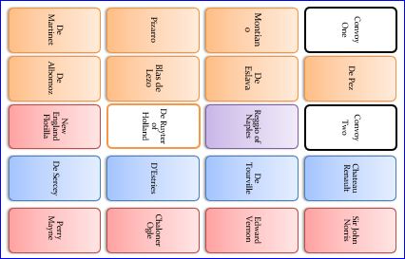

Slide 3
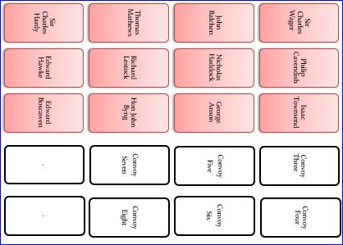

Slide 4
Convoy
One
De Pez
Convoy
Two
Chateau Renault
Sir John Norris
Sir Charles Wager
Philip Cavendish
Isaac Townsend
Convoy Three
Convoy Four
Montiano
De Eslava
Reggio of Naples
De Tourville
Edward Vernon
John Balchen
Nicholas Haddock
George Anson
Convoy
Five
Convoy
Six
Pizarro
Blas de Lezo
De Ruyter of Holland
D’Estries
Chaloner Ogle
Thomas Mathews
Richard Lestock
Hon John Byng
Convoy
Seven
Convoy
Eight
De Martinet
De Albornoz
New England Flotilla
De Sercey
Perry Mayne
Sir Charles Hardy
Edward Hawke
Edward Boscawen
.
.

Slide 5
Table of Wind Origins
DIE ROLL/ SEA CODE: | 1 | 2 | 3 | 4 | 5 | 6
N | W | NW | N | N | NE | E
E | S | SE | E | E | NE | N
S | W | SW | S | S | SE | E
SW | NW | W | SW | SW | S | SE
W | S | SW | W | W | NW | N
NW | SW | W | NW | NW | N | S
C | W | SW | S | SE | E | N

Slide 6
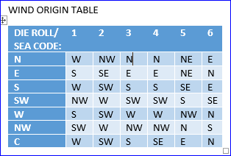
WESTERN APPROACHES W
NORTH ATLANTIC PASSAGE W
AMER-ICA
SW
MADEIRA
N
AZORES
N
MID-ATLANTIC
N
SARGASSO SEA
N D
CANARIES
N
GUIANAS E
CAPE VERDE E

Slide 7
GENOA
VILLE-
FRANCHE
TOULON
LEGHORN
HYERES
ROADS C
Ligurian Gulf C
Golfe
De
Lion
C
Sea of
Sard-
Inia
C
Elba
C
BARCE
LONA
Balearic
Sea
C
BONIFACIO STRAIT CD
Tyrrhenian
Sea
C
NAPLES
MAHON
Barbary Coast C
CARTAGENA
Alboran Sea
C
MESSINA STRAIT
C
Sicilian
Narrows
C
GIBRA
LTAR
Gut of Gibraltar
C
Maltese
Sea
C

Slide 8
NEW
ORLEANS
SAVANNAH
SARGASSO
N
Here be Calms, Weed &
Monsters of the deep
BAHAMAS
SW
GULF
OF
MEXICO
SW
AUGUSTINE
FLORIDA STRAIT W
Shoals
HABANA
The Indies see Tempestes
from June until Novembere
VERA-CRUZ
BAHAMA CHANNEL
S
TORTUGA
HONDURAS GULF
S
SANT
IAGO
WINDWARD
PSSGE
LEEWARD ISLES
NE
MONA
=
PSSGE
SAN_
JUAN
PORTROYAL
PORT LOUIS
CARIBBEAN SEA
E
SPANISH MAIN
SE
CATALINA
MARTIN
IQUE
WINDWARD ISLES
SE
CURACAO
CARTAGENA
PUERTO CABELLO
PORTOBELLO
LA GUIARA
LA HACHA

Slide 9
CHATHAM
THE NORE
SW D
Beware Tempestes in Fall & Wintere
PORTSMOUTH
STRAIT OF DOVER
SW
D
SPITHEAD ROADS
SW
AUST-RIAN
NETHERLAND
PLYMOUTH
LYME BAY
SW
ENGLISH CHANNEL
SW
Shoals
THE SOUNDINGS
SW
START
POINT
SW
Rocks
THE CHOPS
SW
CHERBOURG
DIEPPE
BAIE DE MORLAIX
SW
CHANNEL
ISLANDS
SW D
BAIE DE LA SEINE
SW
USHANT
W D
BREST

Slide 10
WESTERN APPROACHES
W
L’ORIENT
AIX ROADS
NW
BAY OF BISCAY
NW
CAPE FINISTERRE
NW
ROCHE-FORT
FERROL
SAN
SEBASTIAN
VIGO
CAPE MONDEGO
NW
O’PORTO
CABO RASO
NW
LISBON
CAPE ST VINCENT
NW
Beware Tempestes in Fall & Wintere
CAPE TRAFALGAR
N
CADIZ
GUT OF GIBRALTAR C

Slide 11
GULF OF ST LAWRENCE
C
SEPT ILES
CARTIER STRAIT
C
ST LAWRENCE RIVER
C
HONGUEDO STRAIT
C
CHALEUR BAY
C
Red men
be here
NORTHUMBERLAND STRAIT C
QUEBEC
FUNDY
BAY SW
LOUISBURG
MONTREAL
HALIFAX
BANKS
SW
GULF OF MAINE
SW
PORTLAND
Beware Tempestes in Fall & Wintere

